Slide 1
Writing an Effective Resume
For the US Job/Internship Search
Notes:
Staci

Slide 2
Learning Outcomes
After reviewing this presentation, students will be able to:
Understand the purpose of a resume in one’s job/internship search search
Summarize the role a reader’s perspective has in reviewing a resume
Develop an impactful accomplishment statement, concisely describing important elements of one’s experience
Construct an effective resume providing evidence of alignment with field, organization, or role
Notes:
Staci

Slide 3
What is a resume?
A career document in your job/internship search that details:
Who you are
What you have accomplished
How you will be an asset to an organization and can transition to the desired role
Tells the story of your:
Experiences
Provides evidence of your:
Skills
Accomplishments
Qualifications
Notes:
Staci

Slide 4
Understanding the Reader’s Point of View
What do US companies want? Employees who demonstrate a match to the company with their:
Strengths
Are you able to do the job effectively?
Motivation
Do you want to do the job?
Fit
Will others in the company enjoy working with you?
Your resume is one way you can demonstrate these three areas to an employer. These areas may be different for each field, organization, or role. Therefore, you need to customize each resume.
Notes:
Staci

Slide 5
Assess Your Experiences & Skills
There are many experiences and skills that can be relevant to the job search and resume writing.
Think about the training and experiences that you have had thus far. What experiences provide evidence of your impact? What skills have you developed? How can these be demonstrated in your resume?
Notes:
Staci

Slide 6
Assess Your Experience
In reviewing your experience, consider:
What did you do?
What did you accomplish?
What did you learn?
What skills did you develop?
How did you develop as an individual person?
Use this reflection to determine which past experiences and accomplishments you will use on your resume. This will continuously change depending on the field, organization, and role to which you are applying.
Notes:
Staci

Slide 7
Assess Your Skills
Technical skills (design, sampling, modeling, programming, news writing)
Transferable skills (research, teaching, project coordination, laboratory management, attention to detail)
Interpersonal skills (listening, mentoring, collaborating, delegating, negotiating improvements, supervising)
These are simply examples of skills. Think beyond these to determine your unique set of skills. View the 2nd page of this Career Center handout to view additional skills.
Notes:
Staci

Slide 8
Skills Employers Consistently Want from the National Association of Colleges & Employers
Communication skills
Teamwork experience
Strong work ethic
Organizational skills
Ability to multi-task
Dependability
Leadership ability
Honesty and integrity
Flexibility
Interpersonal skills
Initiative
Are any of these your skills? How are they reflected on your resume?
Notes:
Staci

Slide 9
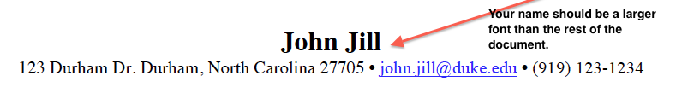
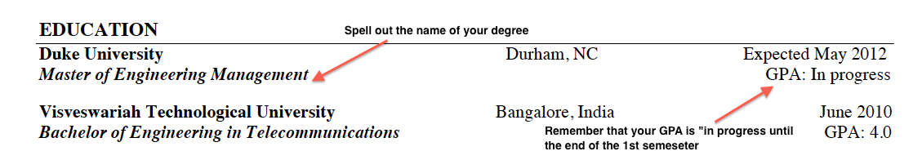
What to Include In Your Resume
NAME (First Name & Family Name)
CONTACT INFORMATION
Phone, Address (City & State are enough), Email (@duke.edu), LinkedIn profile UR
EDUCATION
College/University Name, City, State
Degrees (Master of Engineering and Bachelor of XXX in….), City, State or City, Country
Graduation Date
“Expected” until semester before graduation
GPA (For MEMP or MEng Degree list “In Progress”)
Relevant Coursework (only include specific courses relevant to field, organization, or role)
Notes:
Jenny

Slide 10
What to Include in Your Resume
RELEVANT EXPERIENCE
Paid and unpaid work (full-time or part-time): jobs, internships, externships
Community Service/Volunteering
Research or Course projects that simulate “real-world” experiences
ACTIVITIES & LEADERSHIP
Sports, Student Organizations, Professional Associations,
SKILLS
Technical/Computer
Foreign Language
(do not include English for US based jobs)
Research/Lab
Certifications
Transferable Skills
While some students use Relevant Experience, Activities & Leadership, and Skills as their section headers, you can customize these.
Notes:
Jenny

Slide 11
Resume Tips
Length: 1 page (more than 5 years of professional experience may go to 2 pages)
Format: Reverse chronological order (what you have done more recently will be listed first)
Ink Color: Black
Font: Times New Roman or other simple font
Font Size: Between 11pt and 12pt for body of resume. 18pt for Name at top of page.
You should NEVER use font smaller than 11 pt.
Margins: Consistent & no smaller than .5”
Be selective with Bolding, Underlining, Italicizing for EMPHASIS or FORMATTING
Be Clear & Concise
A master resume is a resume that includes all of your experience and can be multiple pages long. It is not given to employers, but can be a valuable resource from which you can customize individual resumes.
Notes:
Jenny

Slide 12
Resume Tips
Always Spell Check & Proofread
Do not include personal info (ex. interests, family plans, marriage status, ethnicity, social security number, photo, etc)
Be SPECIFIC in telling the reader what you have accomplished; the reader should believe the document to be consistent and clear
Use #’s instead of writing them out
Ex: 5 instead of “five”
Notes:
Jenny

Slide 13
Accomplishment
Statements
Notes:
Jenny

Slide 14
Accomplishment Statements
Allow you to demonstrate your value to the reader and describe your experiences.
They are formed by:
Action Verb: A strong verb that describes what you are/were doing.
+
Task: The actual work you were doing.
+
Result/Impact/Value-Add: The outcome which allows the reader to see how you could be an asset to their organization.
Notes:
Staci

Slide 15
Example 1
Action Verb | Organized
Activity/Task | Teambuilding retreat for student organization
Result | One of the most highly attended retreats receiving positive feedback by group members
Accomplishment | Organized student retreat attended by 95% (80 people) of members and received rating of “excellent” by 90% of attendees
When possible quantify your accomplishment statements. This allows the reader to see your impact more fully. This could include %, $, or number of people, projects, etc.
Notes:
Staci

Slide 16
Example 2
Action Verb | Researched
Activity/Task | Genetic defects in mice
Result | Primary Investigator received $10,000 grant for further genetic testing and research
Accomplishment | Researched genetic defects in mice to find cure for cystic fibrosis; work included in journal publication and resulted in $10,000 grant
Notes:
Staci

Slide 17
Example 3
Good:
Consulted with organization to improve dining services on campus
Better:
Researched and developed a long-range strategic plan reversing the College’s decision to privatize the restaurant’s operation
Note the difference between generic statements of what was done (the good statement), and thinking deeper about how their tasks impacted the company (the better statement). This made it easier for a company to see how the experience could be transferrable to the new company.

Slide 18
Remember
By reading your resume, the reader should understand who you are and how that relates to what they are seeking.
Resumes will initially be read quickly and at times, not thoroughly. The information you provide must be relevant to the reader and attract their attention.

Slide 19
Next Steps
View the sample resumes sent in the email along with this tutorial
Submit your new resume to the Pratt Professional Masters Career Services Team by July 20, 2016
To submit, upload your resume in pdf format on Sakai under your respective page MEMP Org. Site or the MEng Org. Site. Under this section you will see Assignments and the requirement to upload your resume.

Slide 20
We look forward to seeing
you in August!

